Slide 1
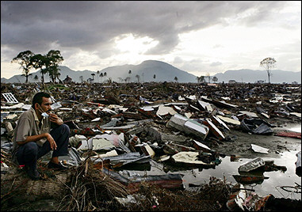
Recurrence of Extreme Geophysical Events in Indonesia
Ron Harris
Brigham Young University
USA

Slide 3
AGU - What is Our Responsibility?
Fundamental research and monitoring of natural hazards
Dissemination of relevant results to the public, especially vulnerable communities
Implementation of multidisciplinary efforts needed to apply effective mitigation strategies worldwide.
(EOS 11 Jan. 2005)

Slide 4
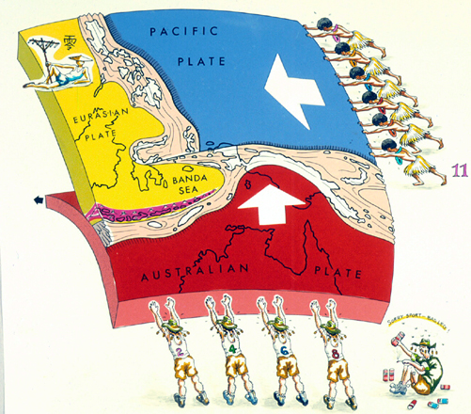
Asian Plate
(stationary)
Pacific Plate
Indo/Australian Plate

Slide 5
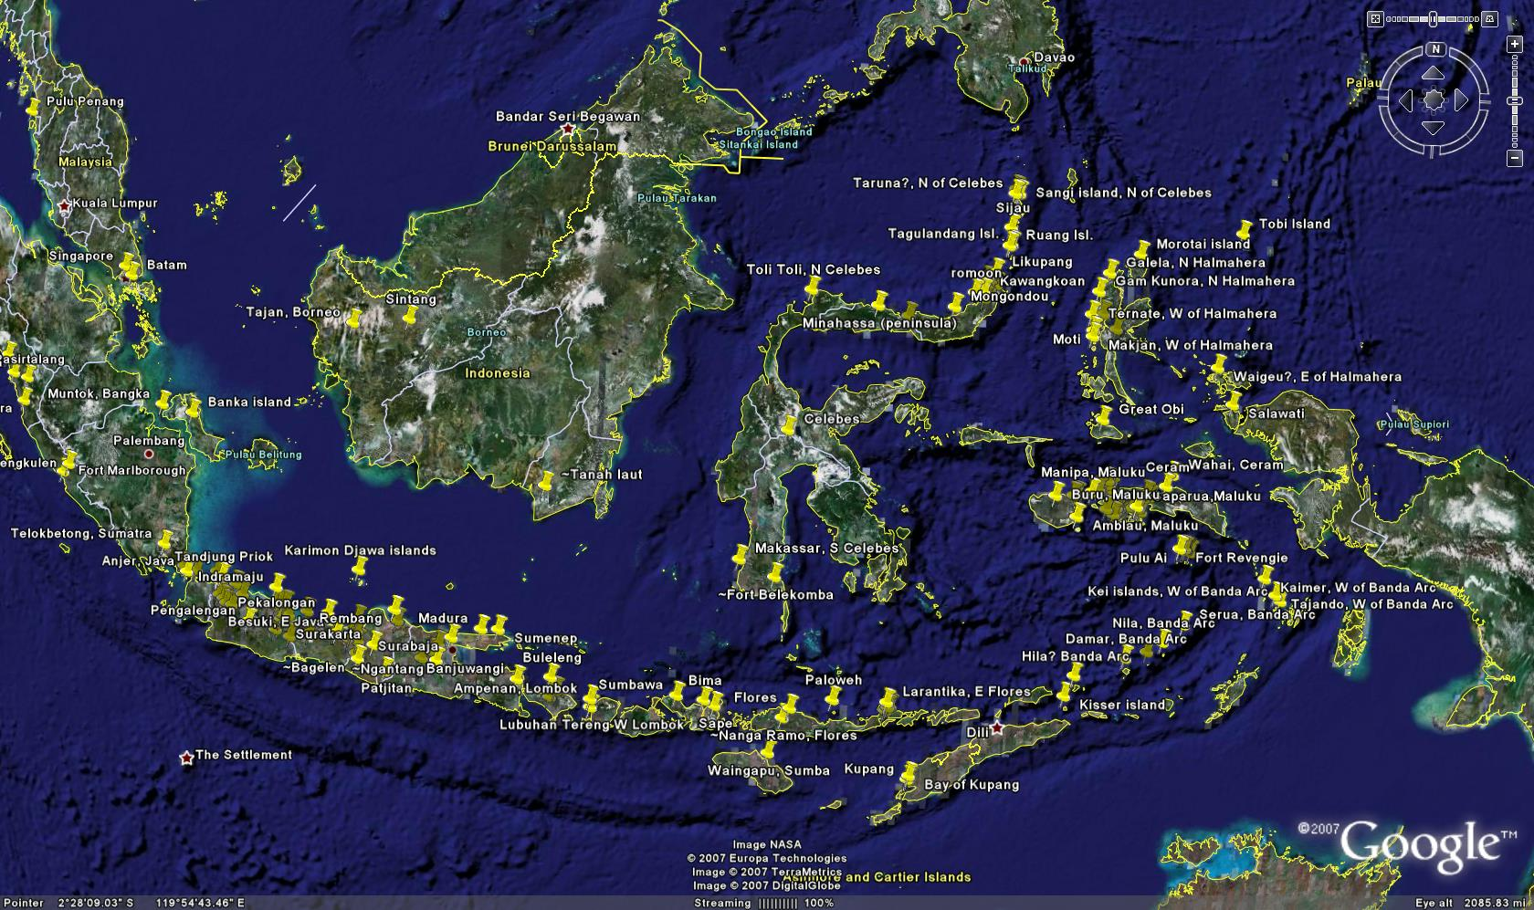
Arthur Wichmann’s Earthquakes of the Indian Archipelago ~ 1600-1877.

Slide 6
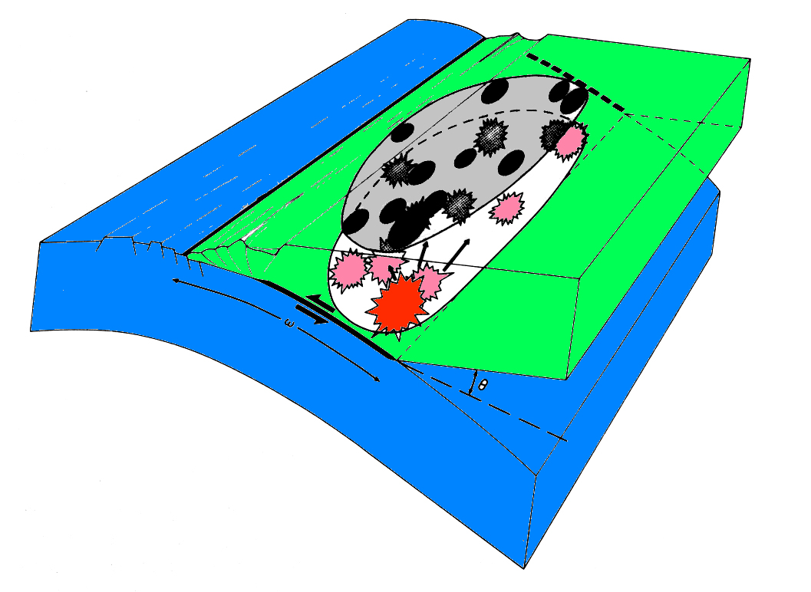
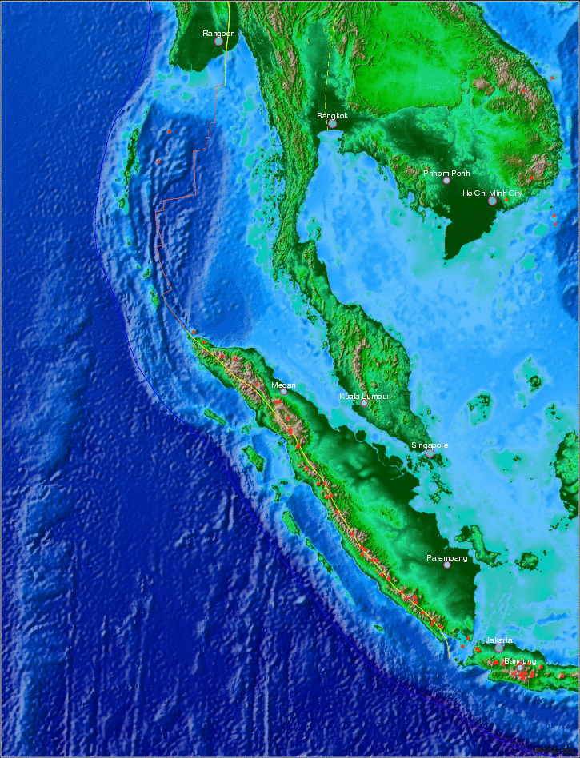
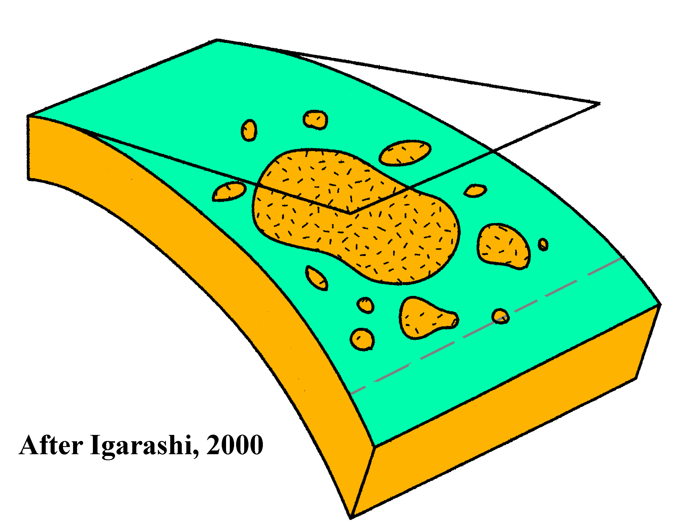
8.1 (1941)
7.9 (1881)
Pressure
V₀ = plate velocity
5-7 cm/a
Toba Eruption 75,000 B.P.
Stick
limit
Time
8.5 (1861)
7.1 (1971)
Recurrence Interval
7.1 (1984)
7.1 (1946)
7.7 (1935)
Sumatra ~150-200 yrs. (mag. 8 to 9)
7.2 (1994)
9.0 (1833)
Krakatau 1883

Slide 7
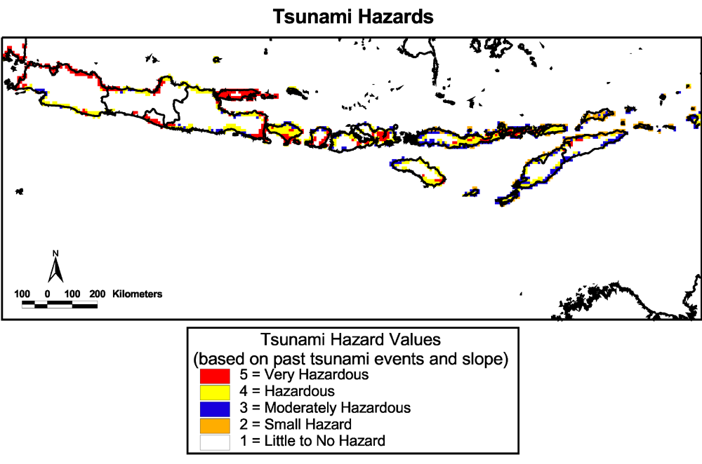
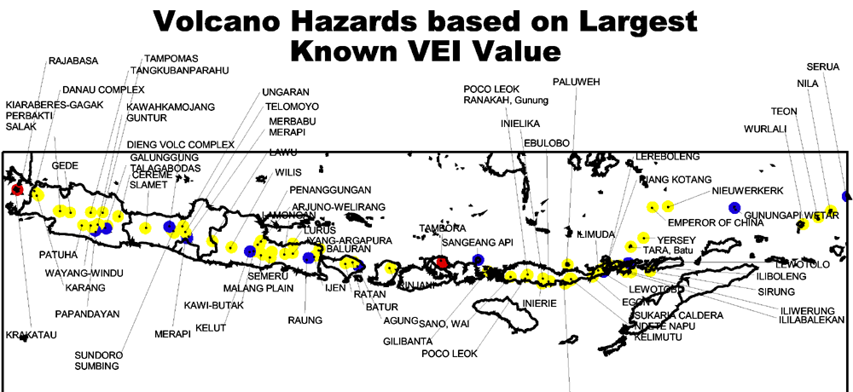
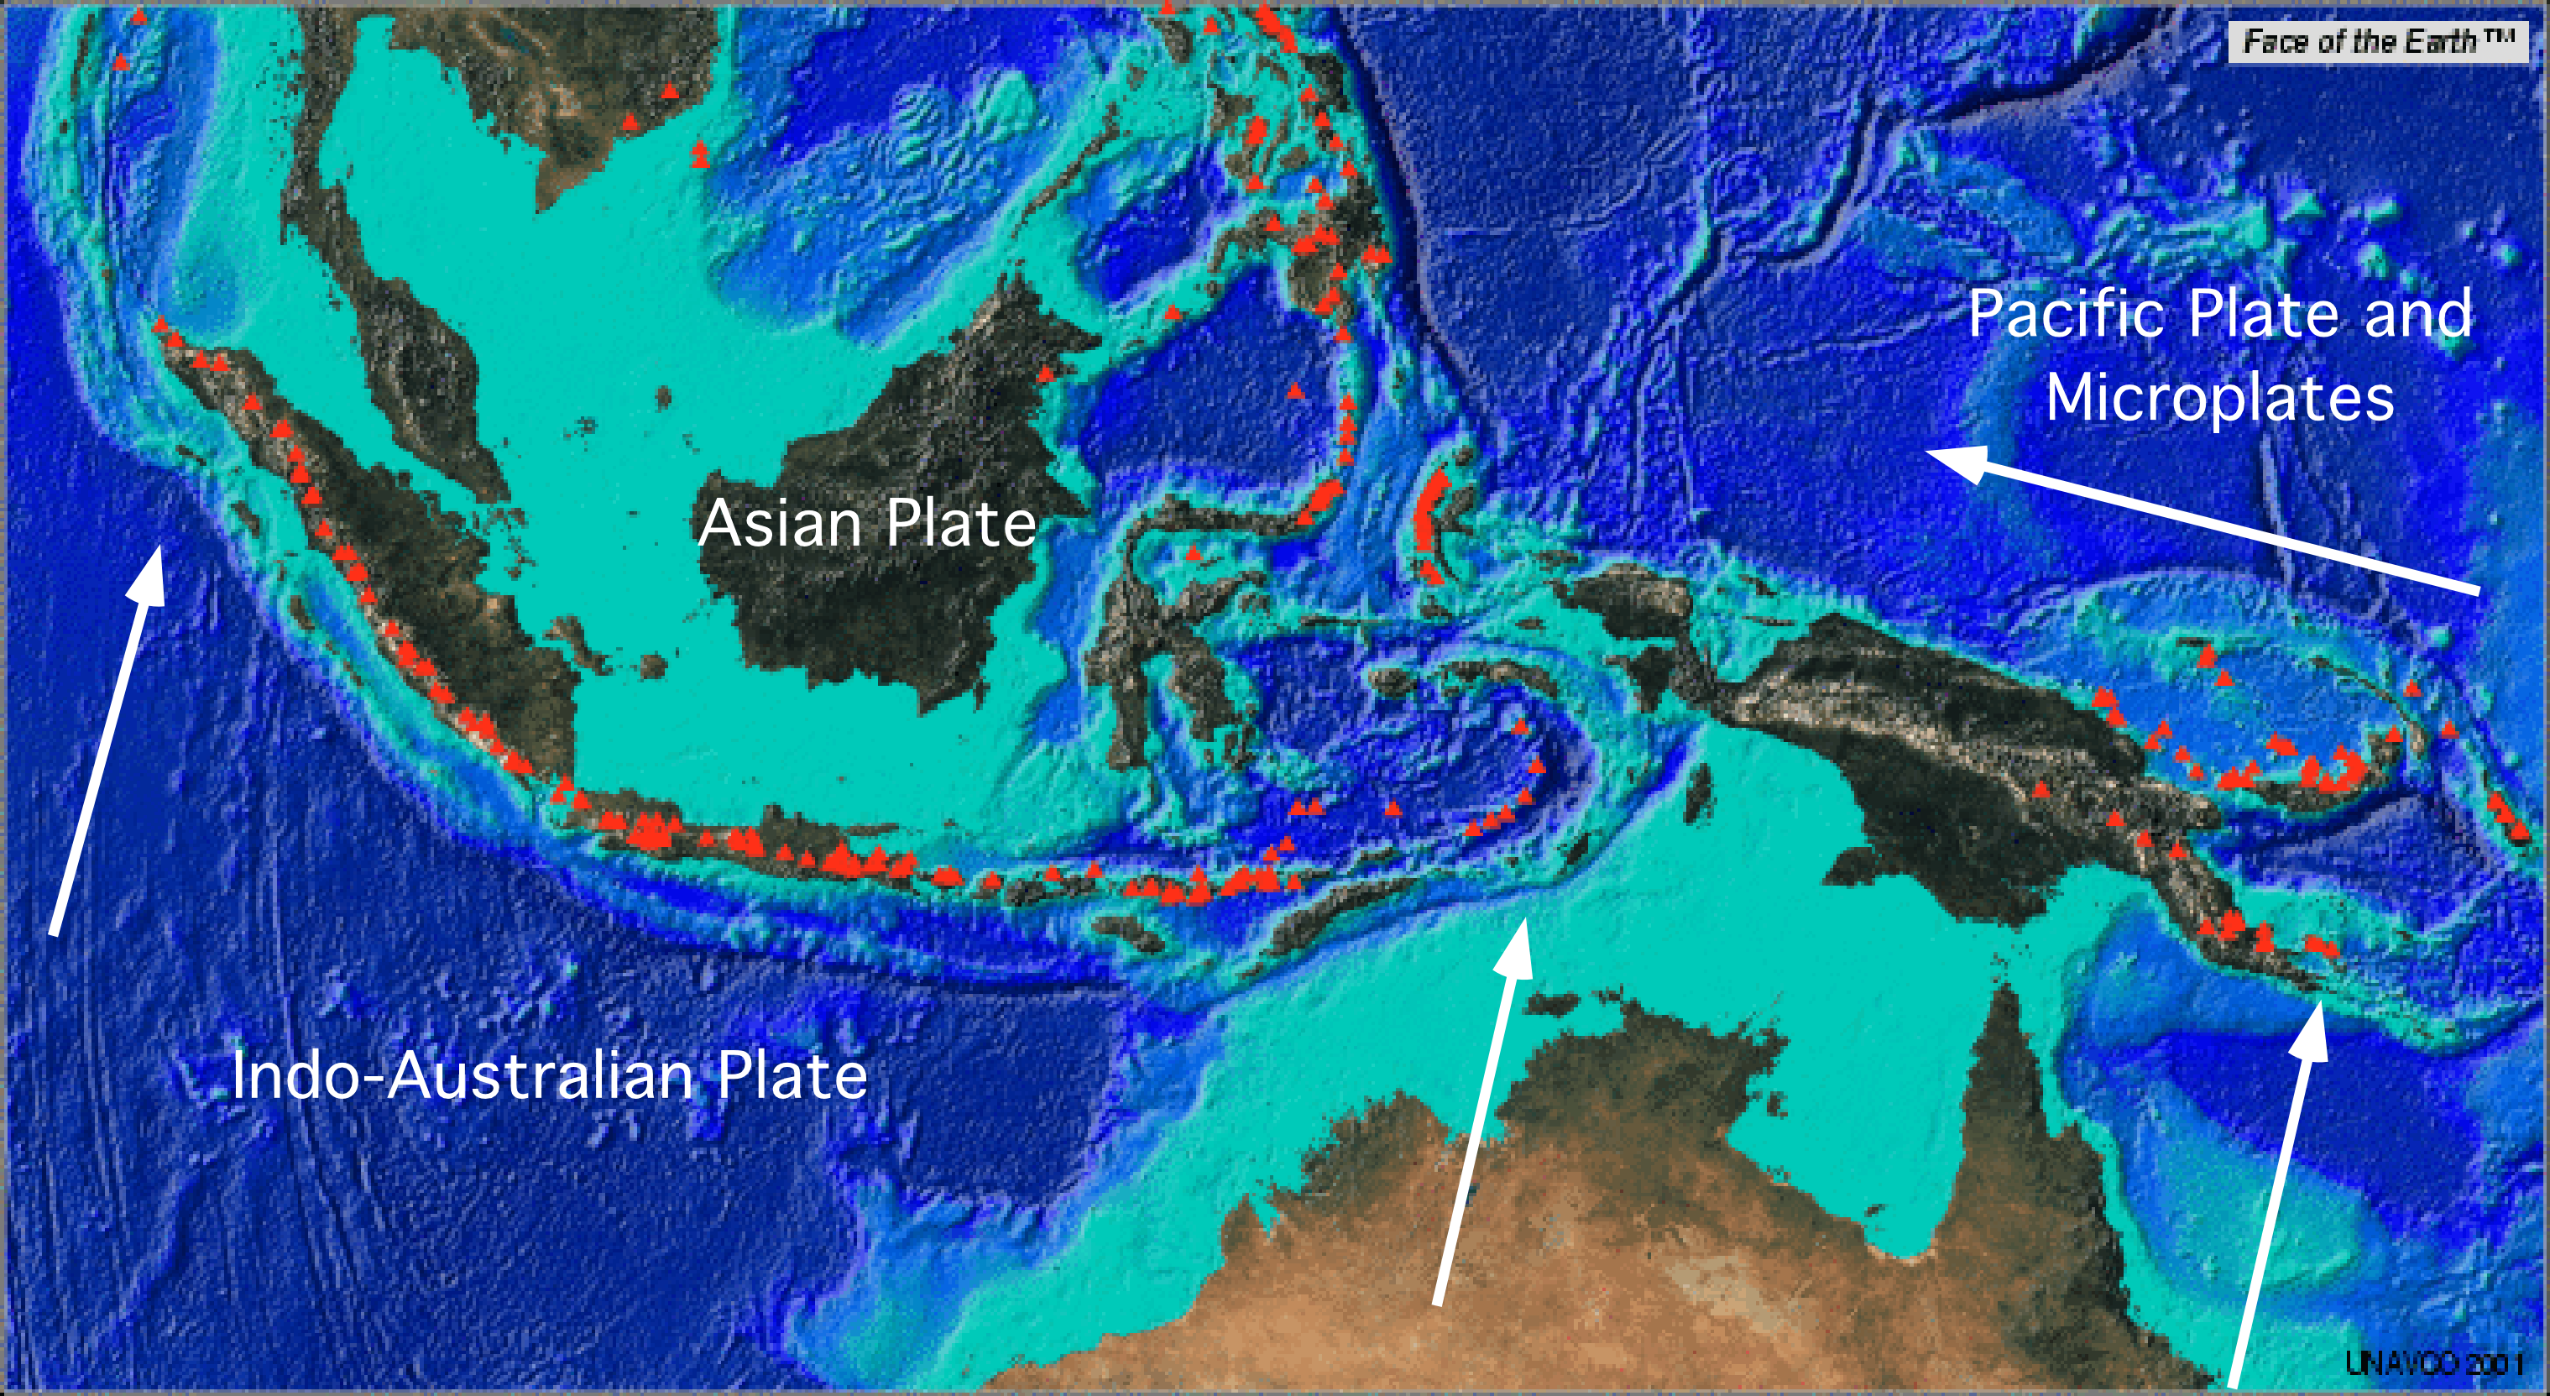
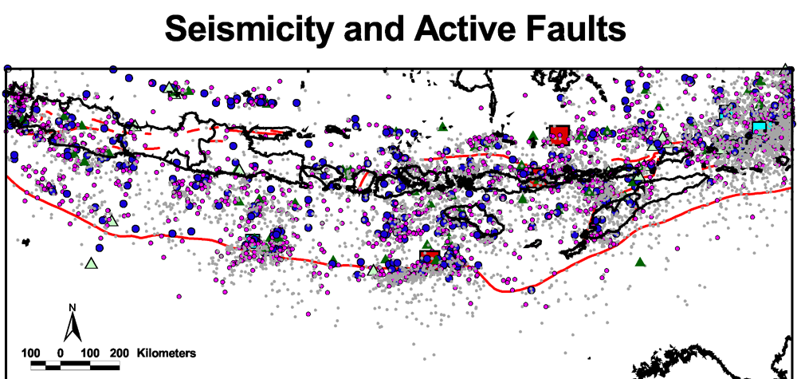

Slide 8
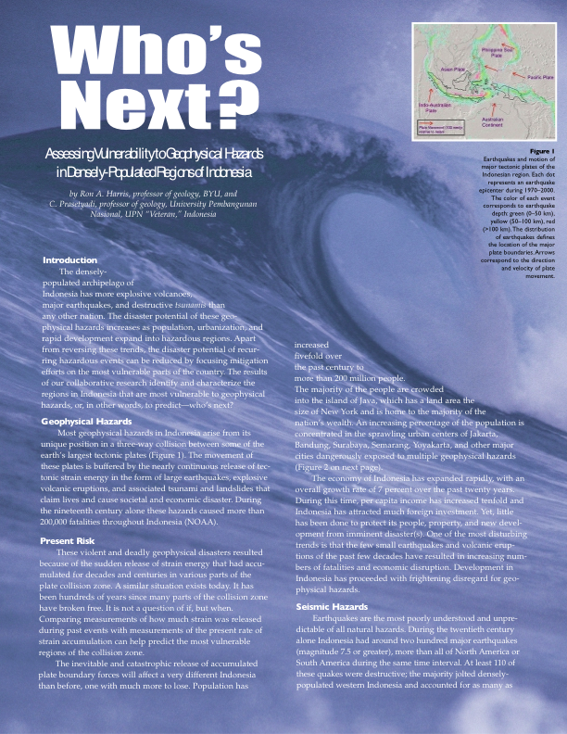
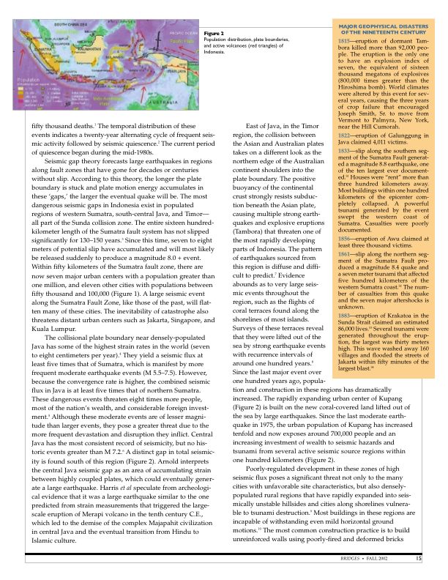
The most dangerous seismic gaps in Indonesia
exist in populated regions of western Sumatra…
The entire 1600 km length of the Sumatran
Fault System has not slipped significantly for
over 130-150 years. Since this time, 7-8 meters
of potential slip have accumulated and
will most likely be released suddenly to produce
a magnitude 8.0 + event!

Slide 10
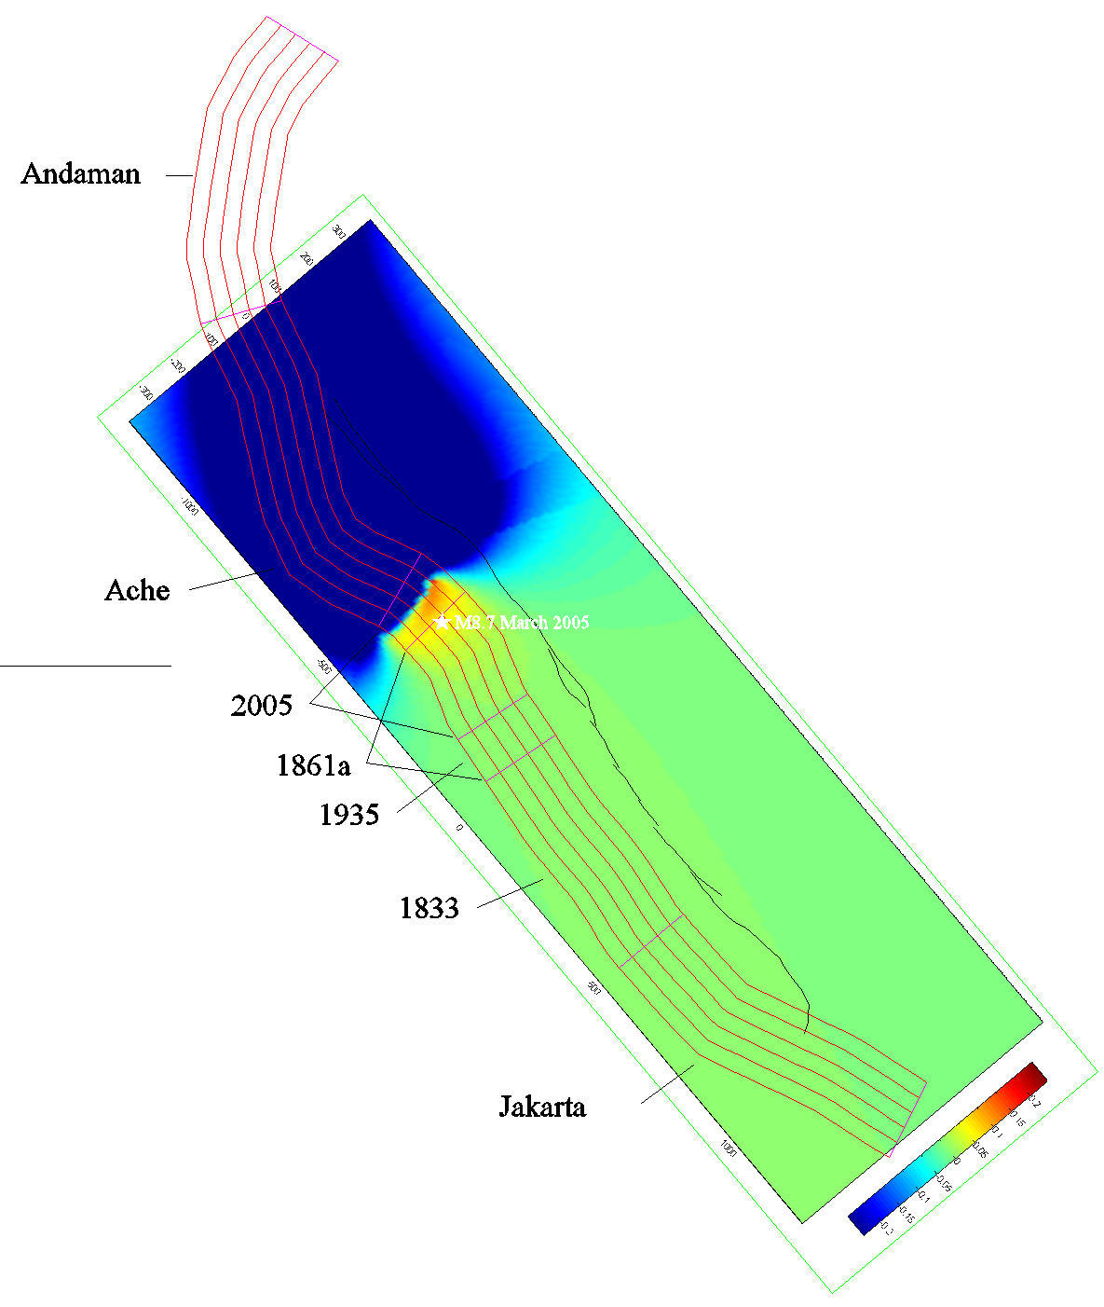
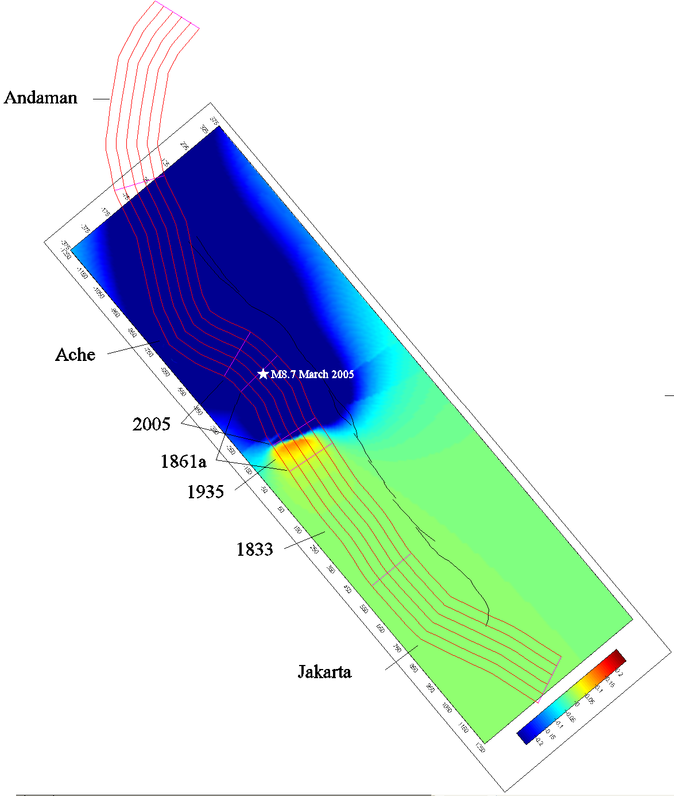
Casualties 1600-1900 ≈ 50,000
Casualties 2000-2011 = 350,000
8.1 (1941)
9.2 (2004)
7.9 (1881)
8.7 (2005)
8.5 (1861)
7.1 (1971)
7.1 (1984)
7.1 (1946)
7.7 (1935)
Krakatau 1883
7.2 (1994)
9.0 (1833)
7.5 (2007)
8.4, 7.9, 7.1 (2007)
6.7 (2006)
7.7 (2006)

Slide 11
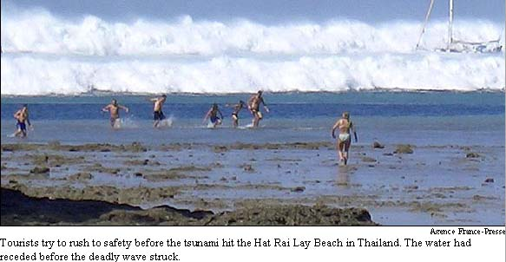
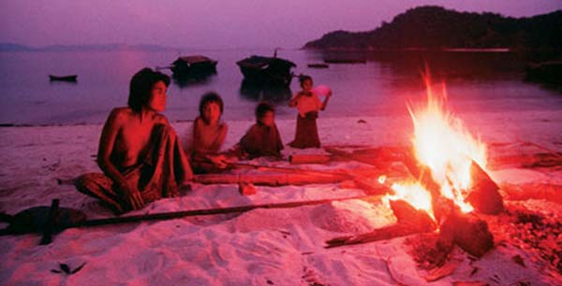
Tilly Smith’s education saves her family and around 100 other people from tsunami in Pucket
Moken Sea Gypsies warn of Laboon – wave that eats people
Simeulueans – ‘Smong’

Slide 12
AGU - What is Our Responsibility?
Fundamental research and monitoring of natural hazards
? Dissemination of relevant results to the public, especially vulnerable communities
? Implementation of multidisciplinary efforts needed to apply effective mitigation strategies worldwide.
(EOS 11 Jan. 2005)

Slide 13
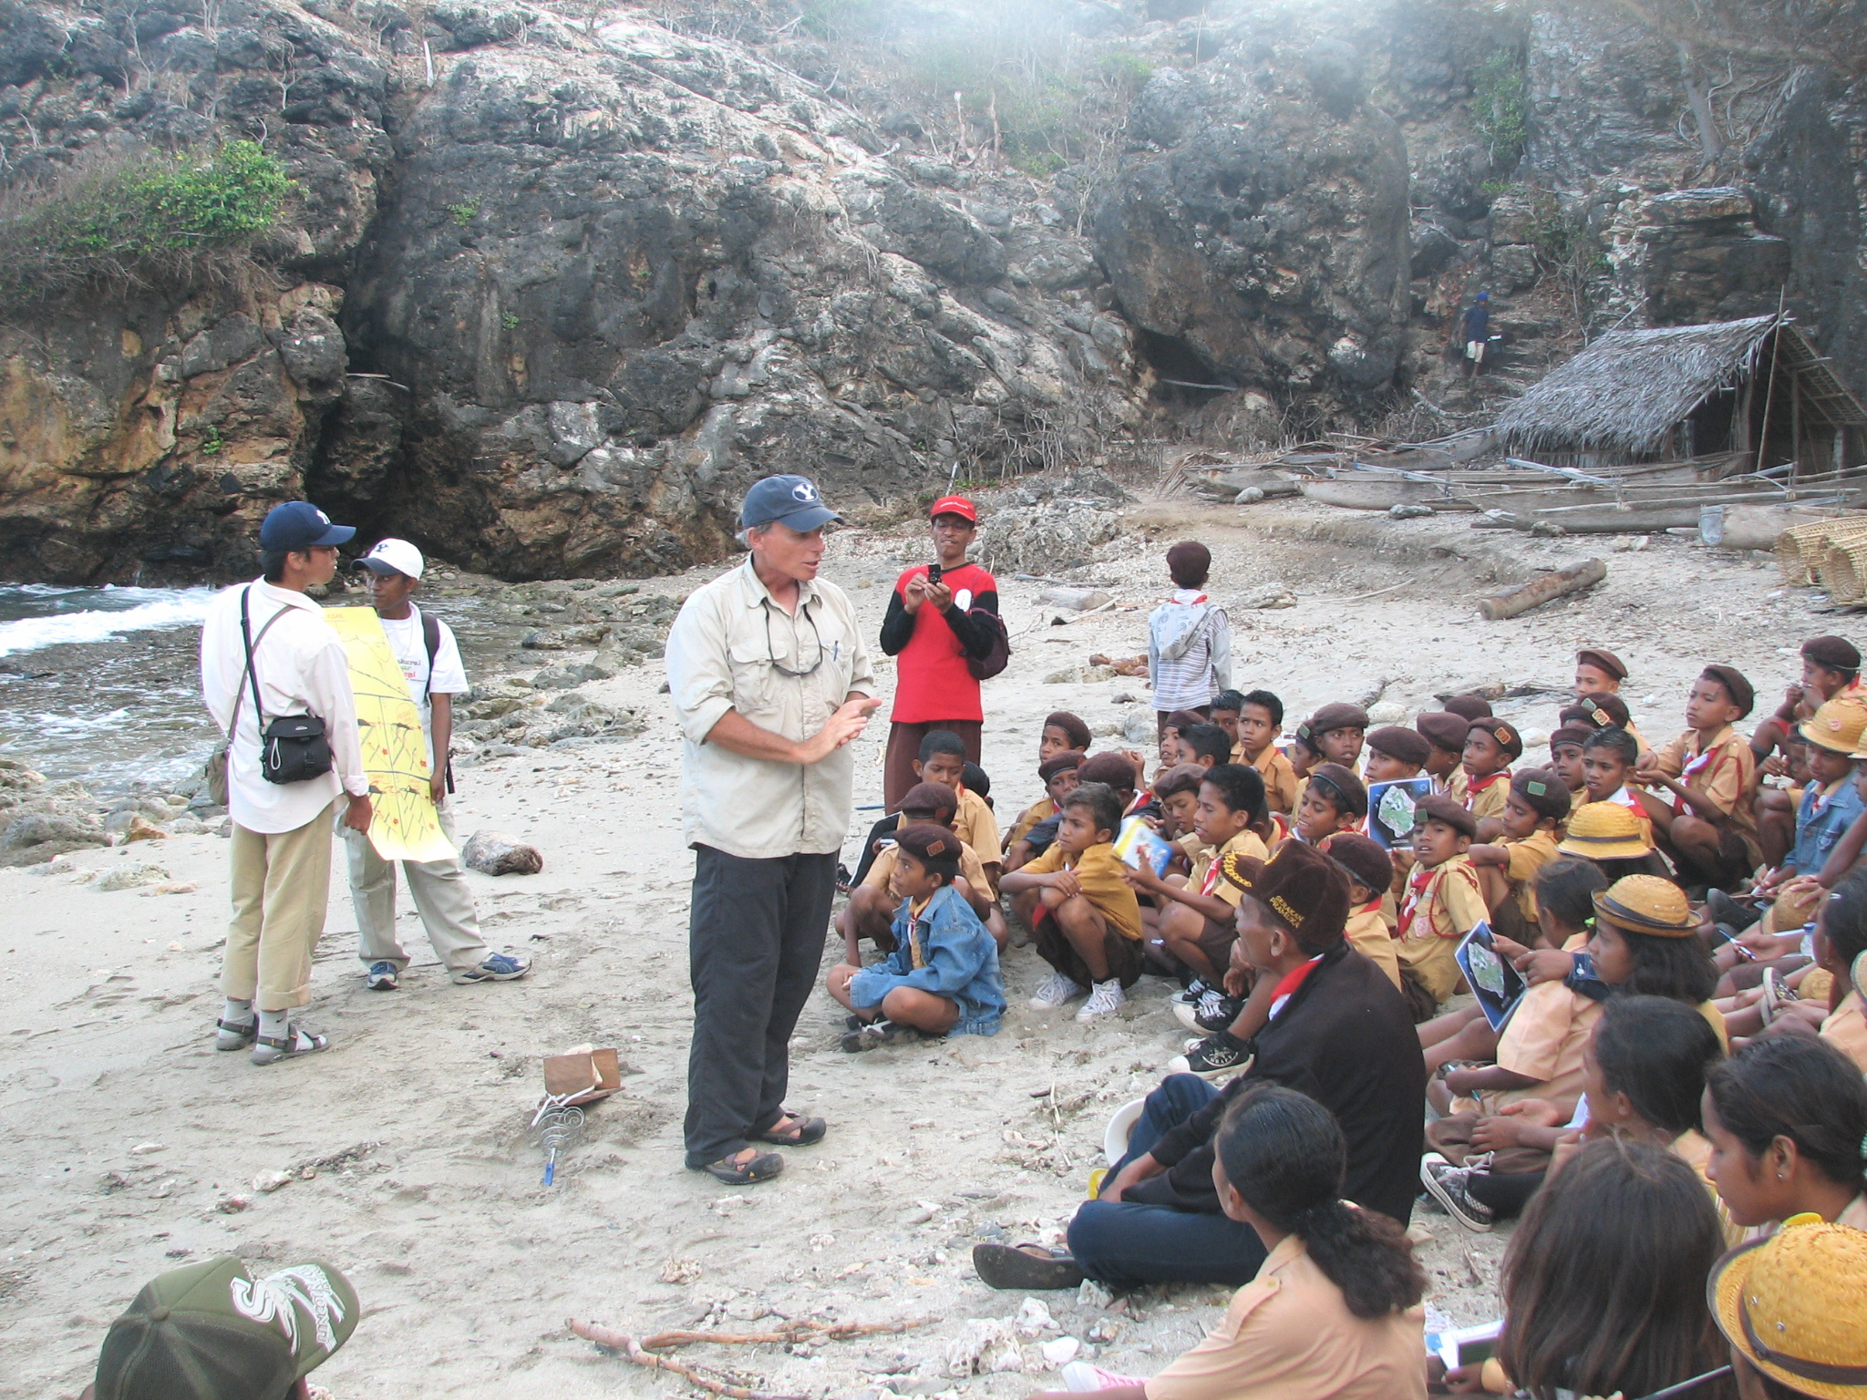
Communication and Implementation
In Harms Way (non-profit organization)

Slide 14
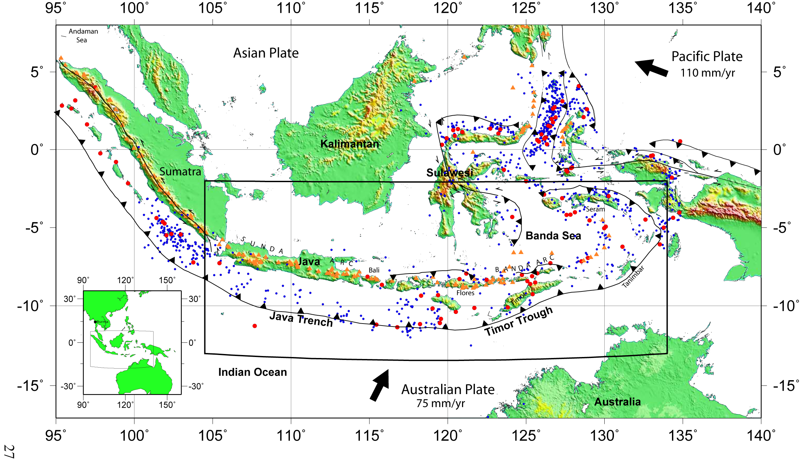
What About Recurrence in Java and Eastern Indonesia?
Major Cities > 0.5 million
Cities > 3 million
Megacities >8 million

Slide 15
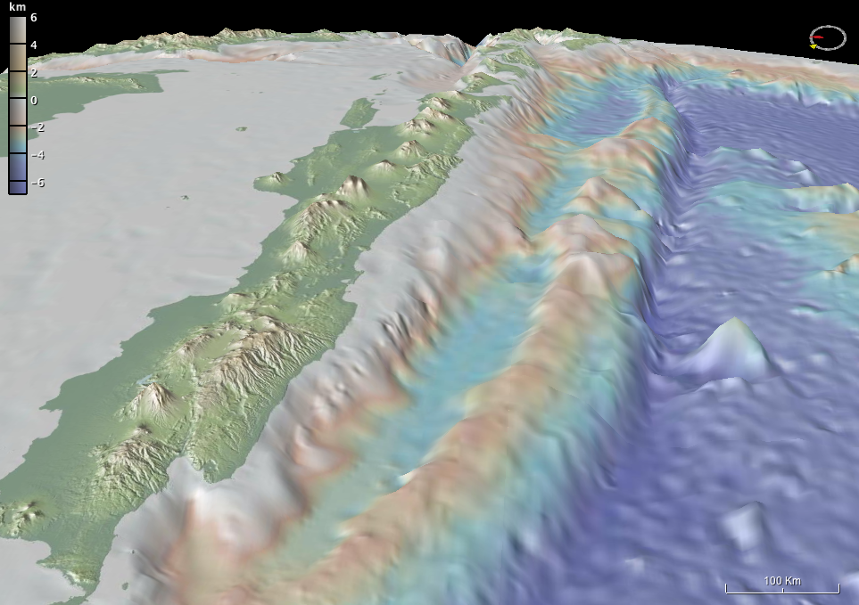
140 million people

Slide 16
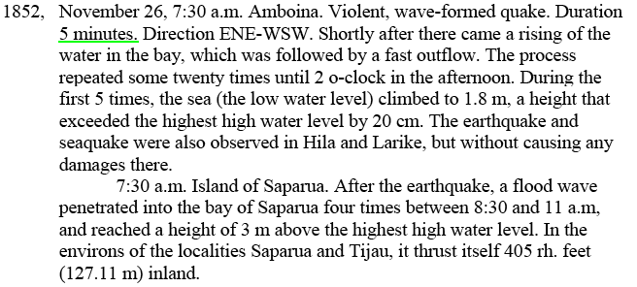

Slide 17
Dutch Historical Records

Slide 18
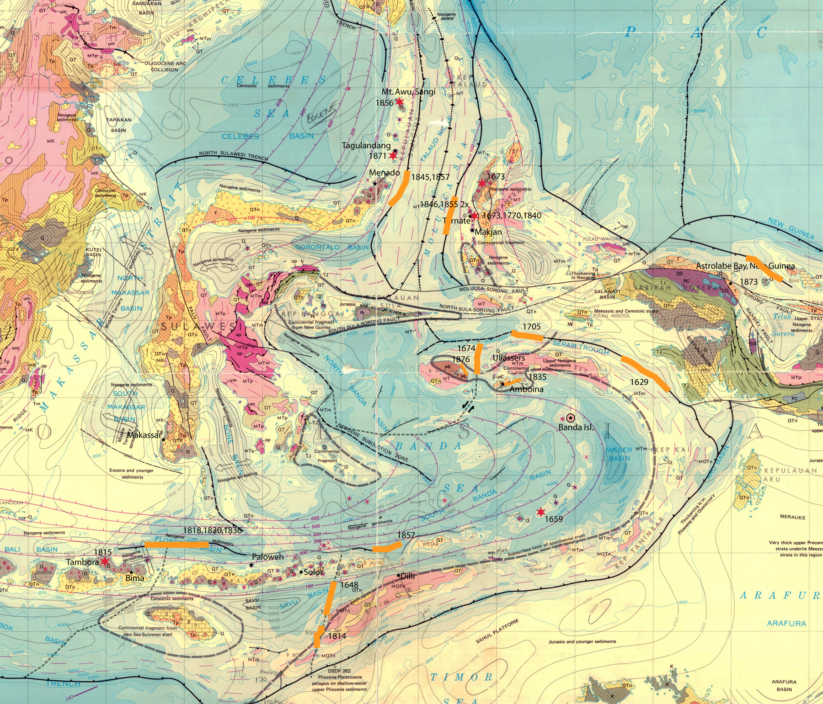
1629
1820
1820
1815
1852
1814
Map from Hamilton, 1979

Slide 19
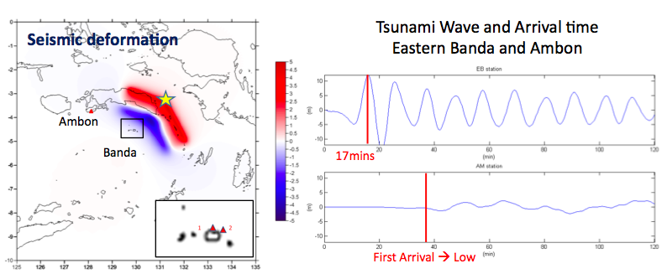
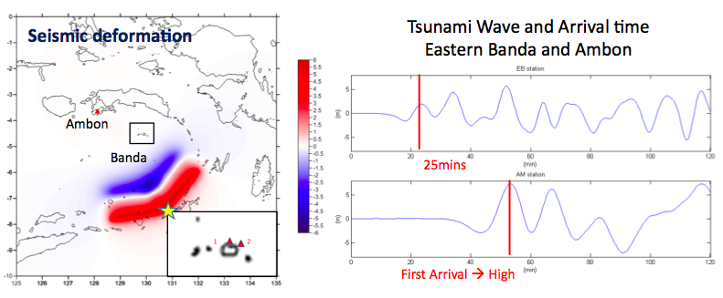
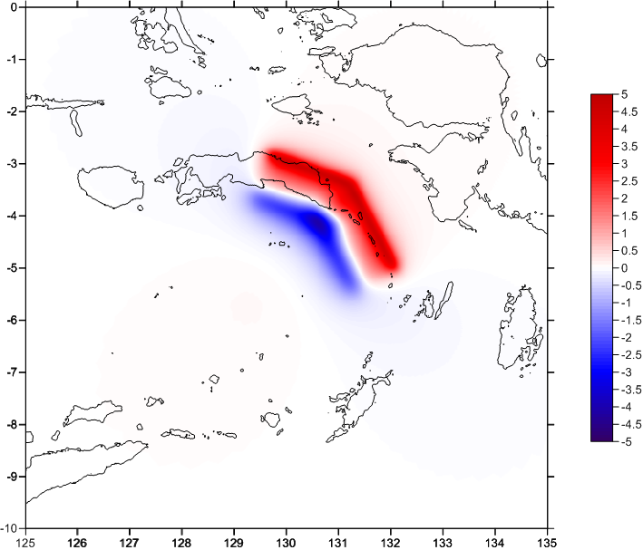
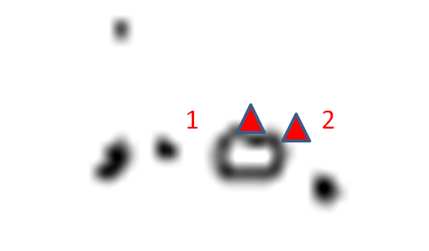
Tsunami Modeling
1629
1852

Slide 20
Patterns of Recurrence

Slide 21
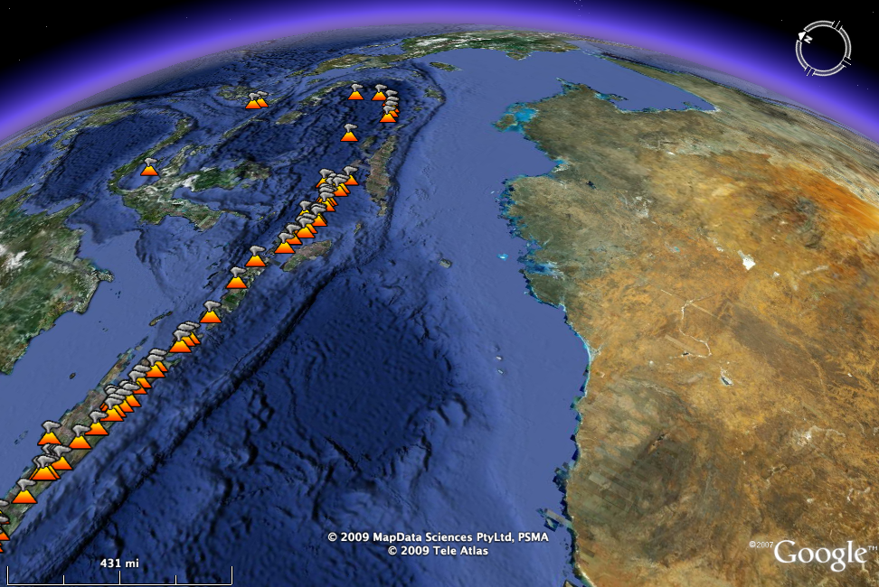
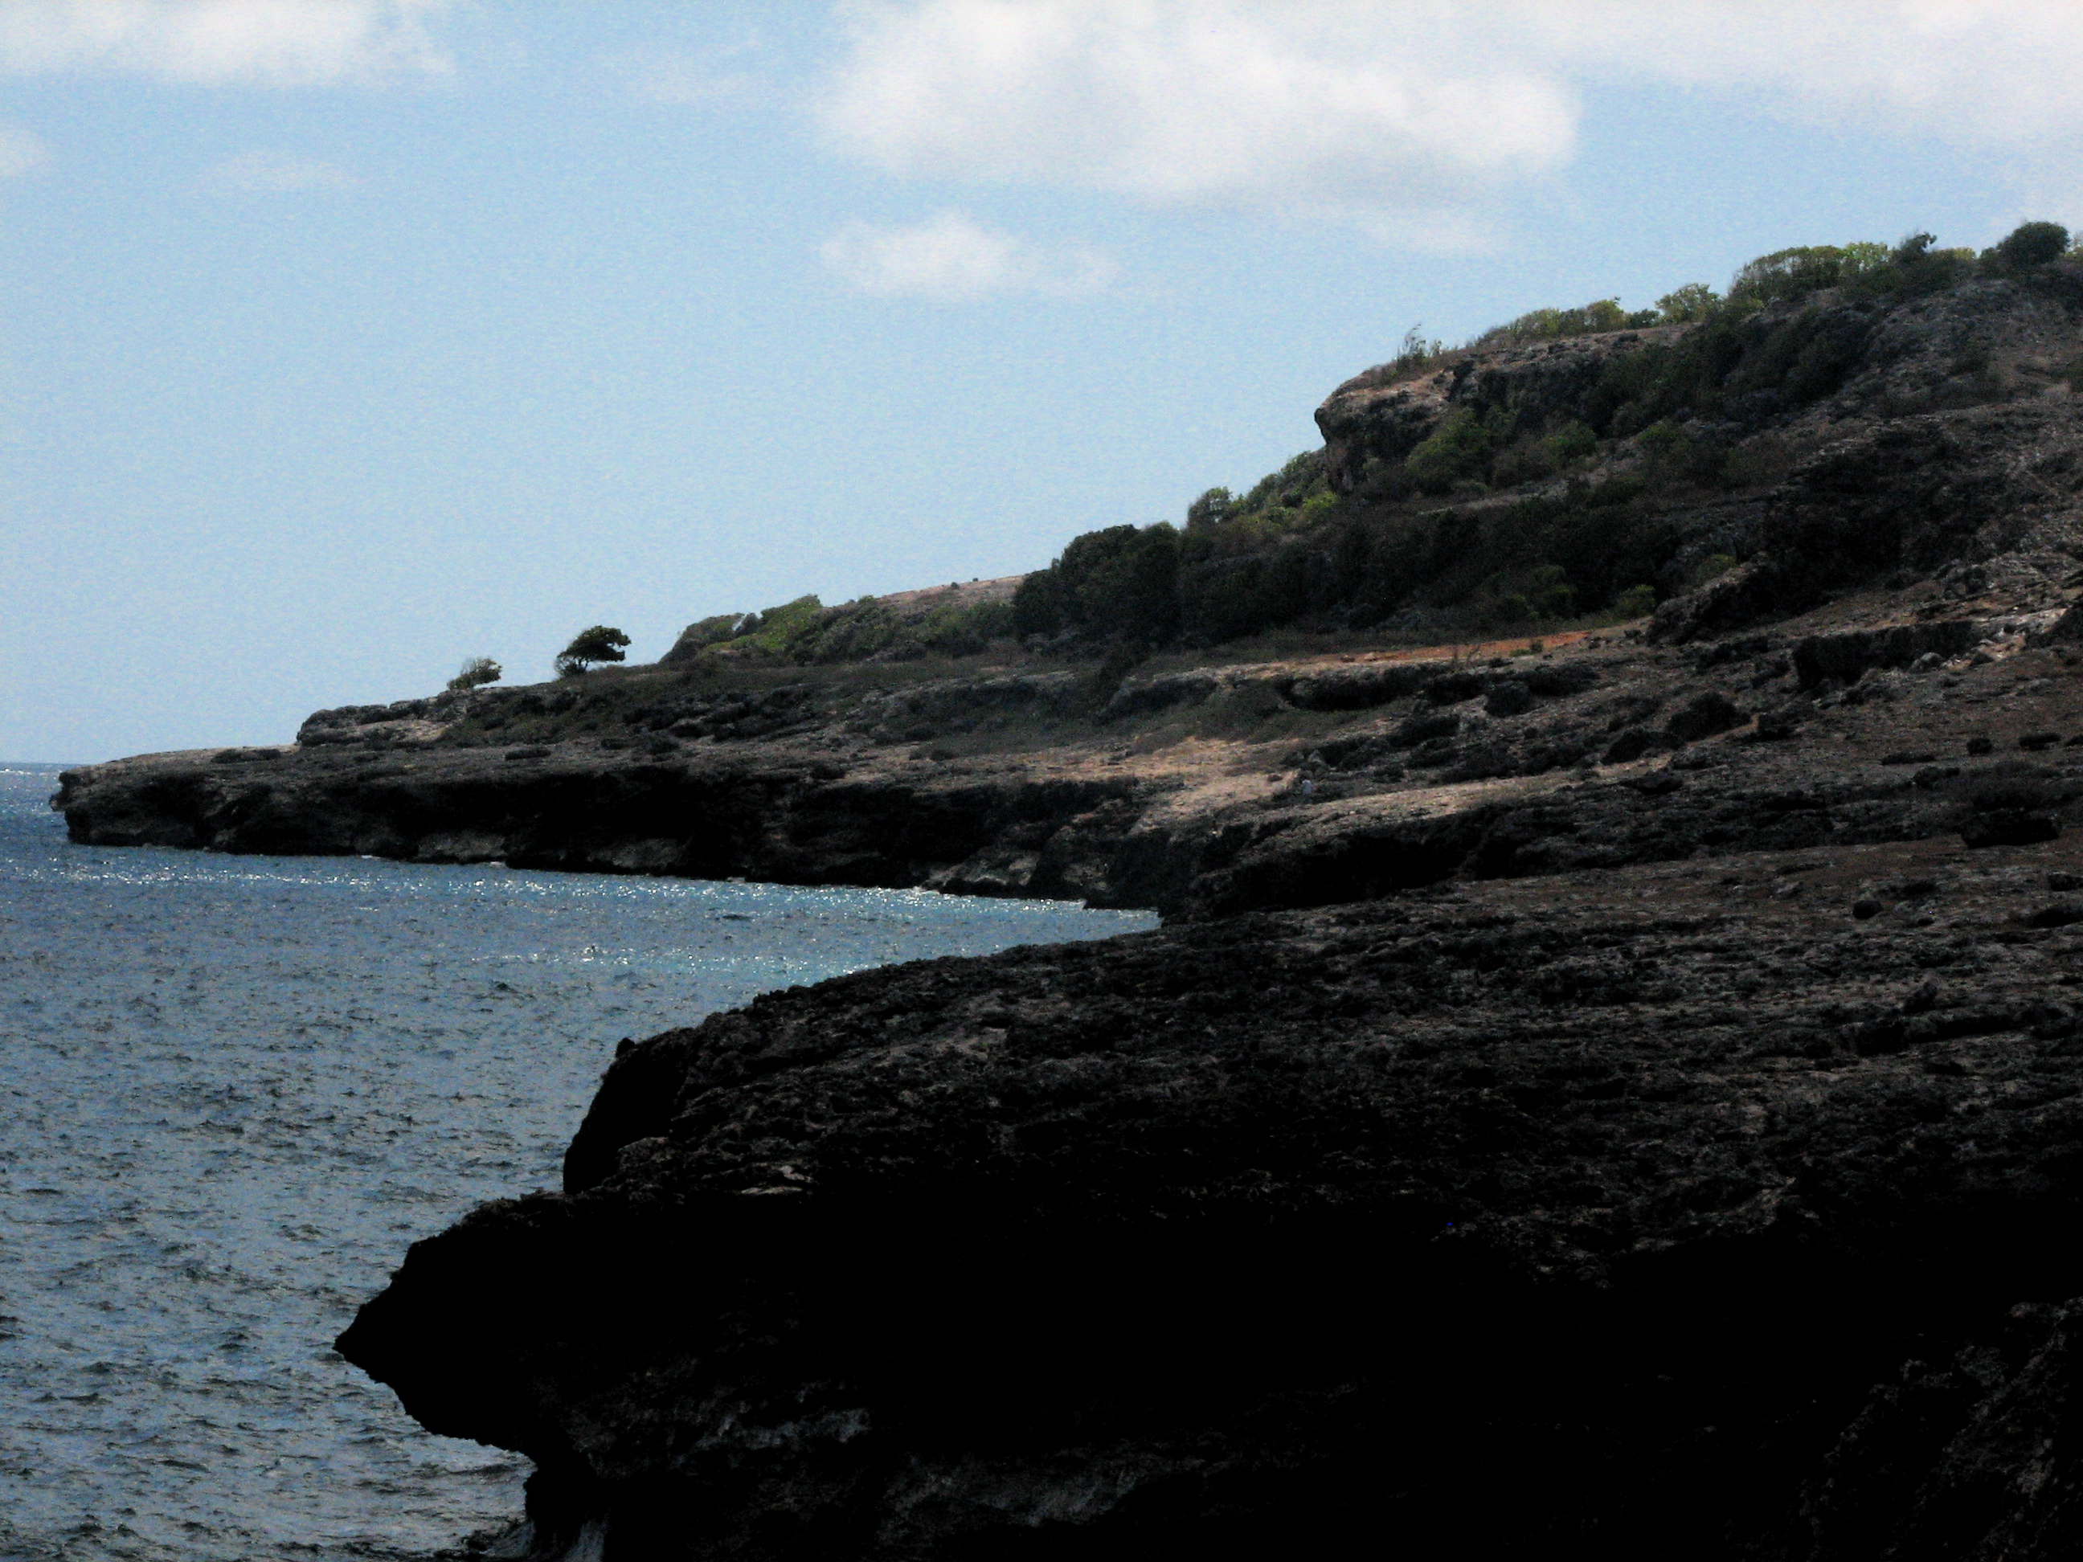
Finding Active Faults using Geomorphology
Banda A-C
Collision
Zone
Sunda
Subduction
Zone

Slide 22
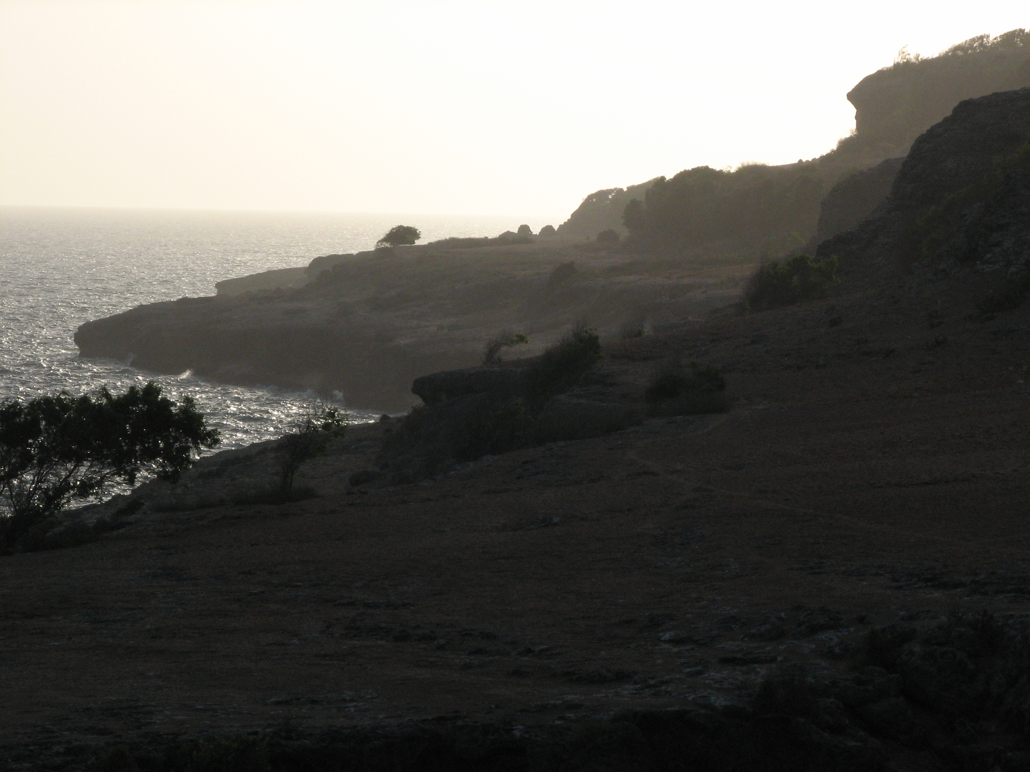
Uplifted Coral Terraces, Banda Sea Region

Slide 23
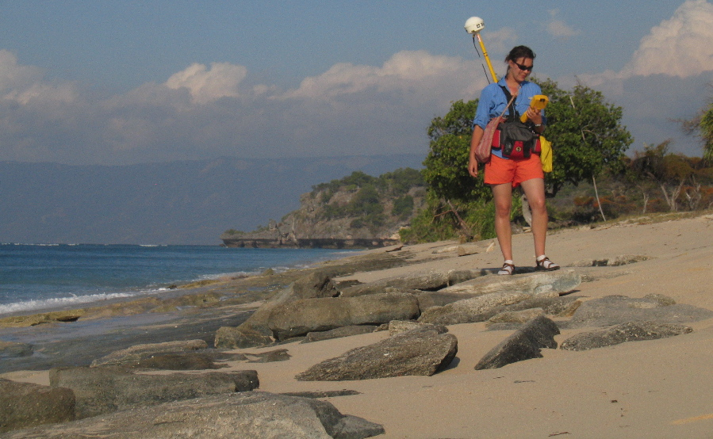

Slide 24
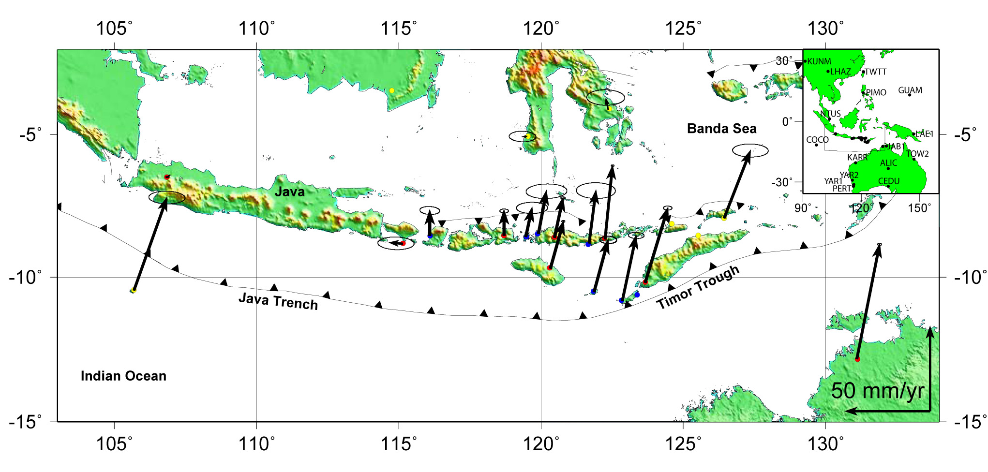
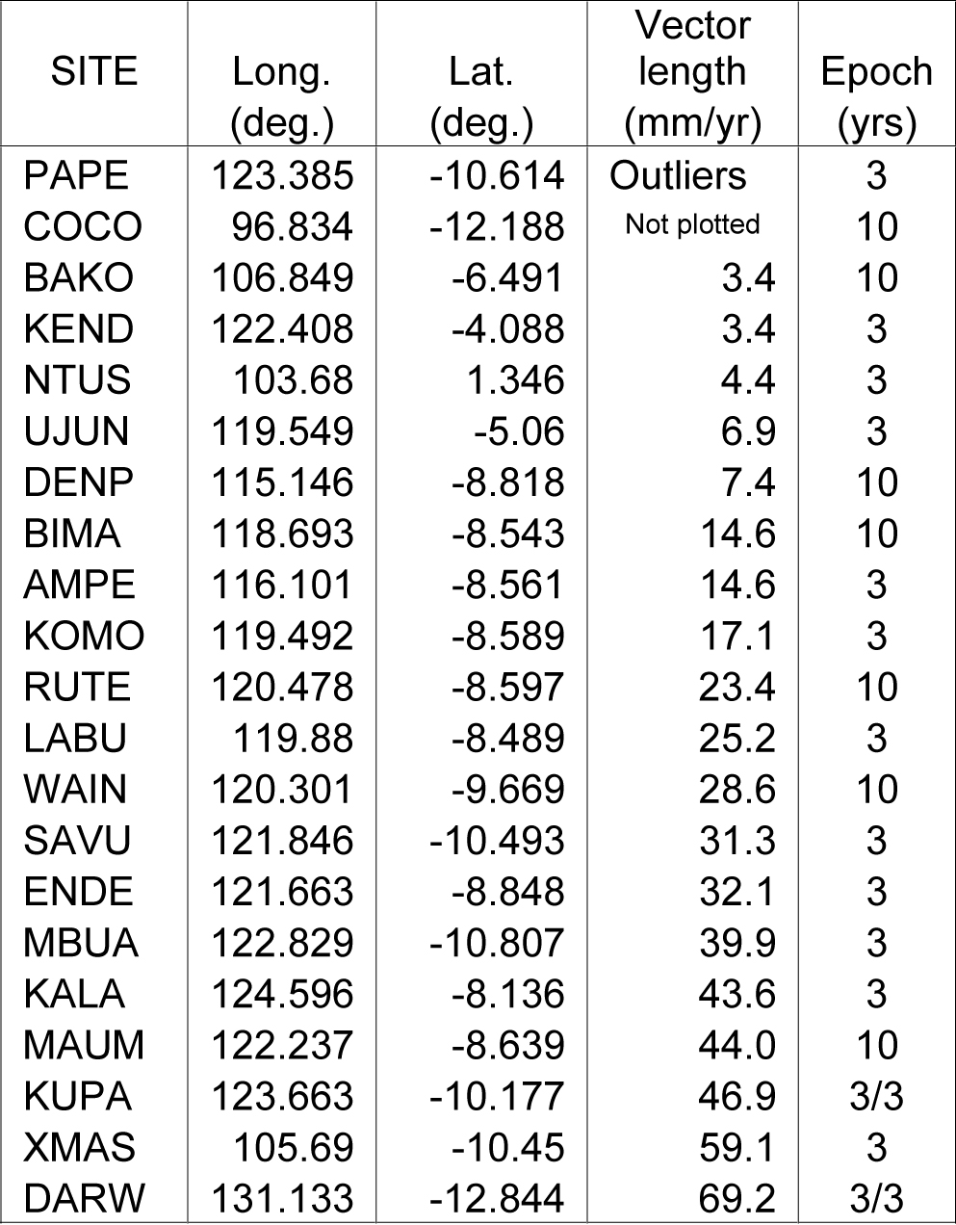
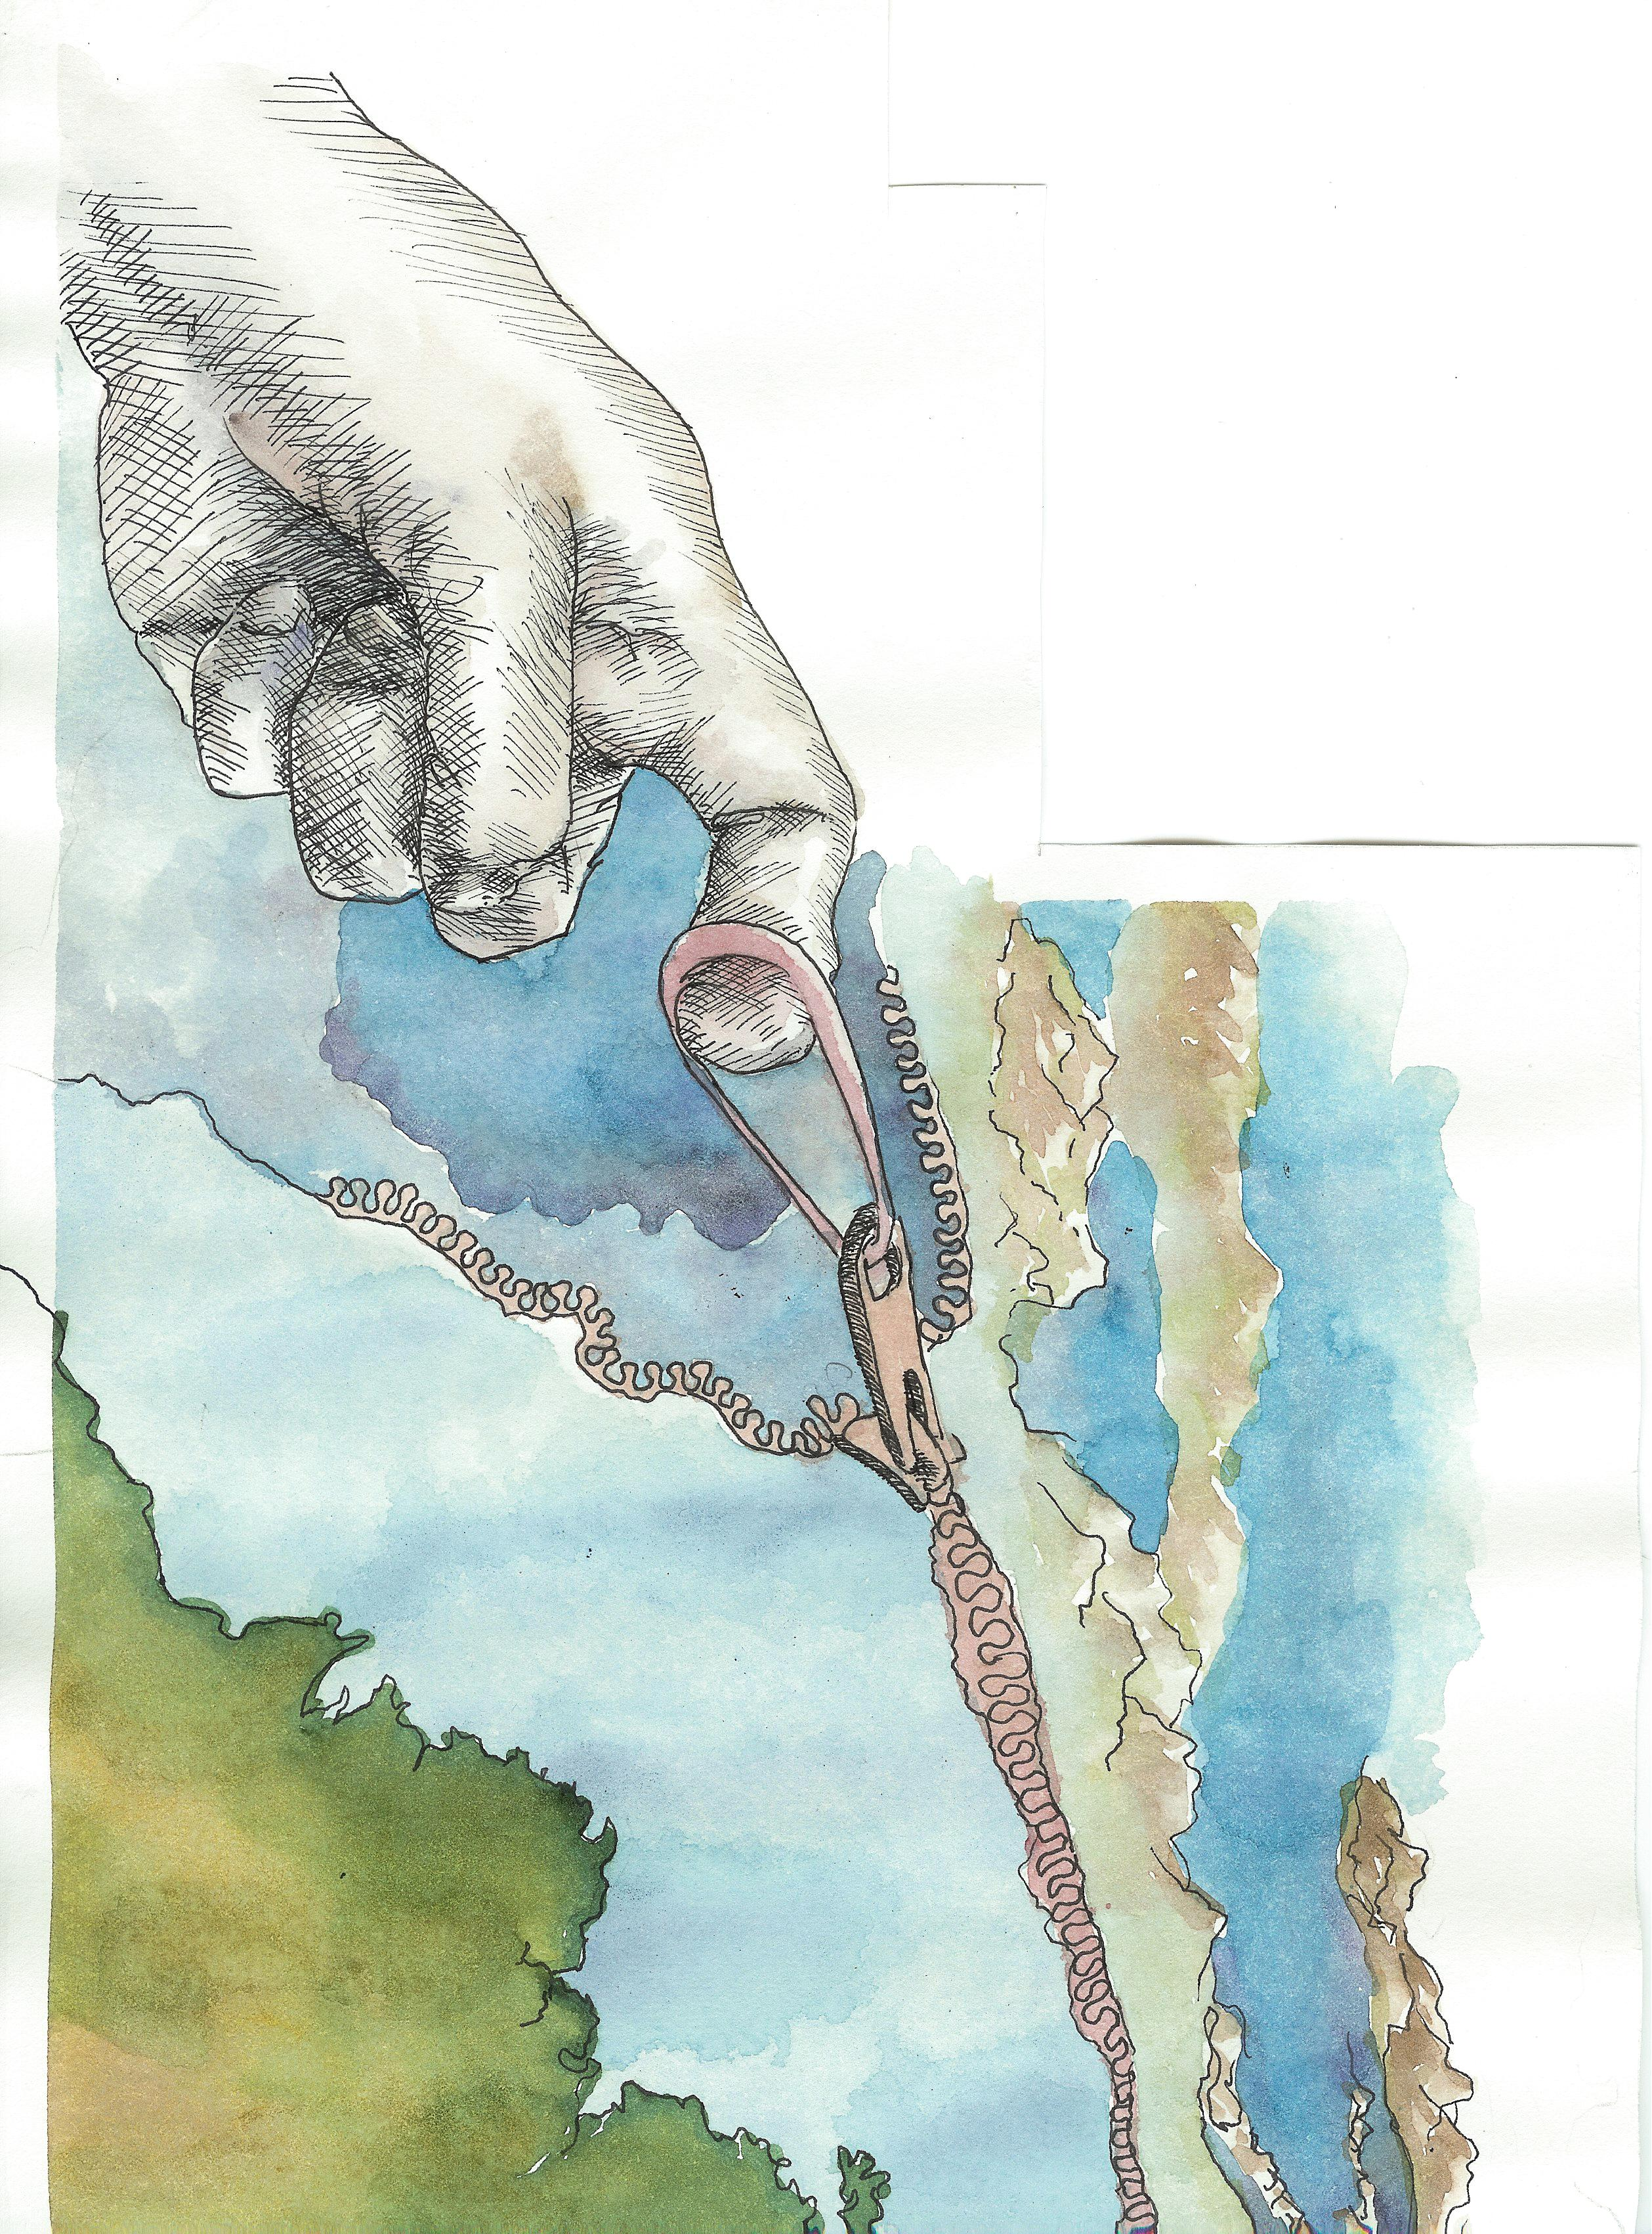
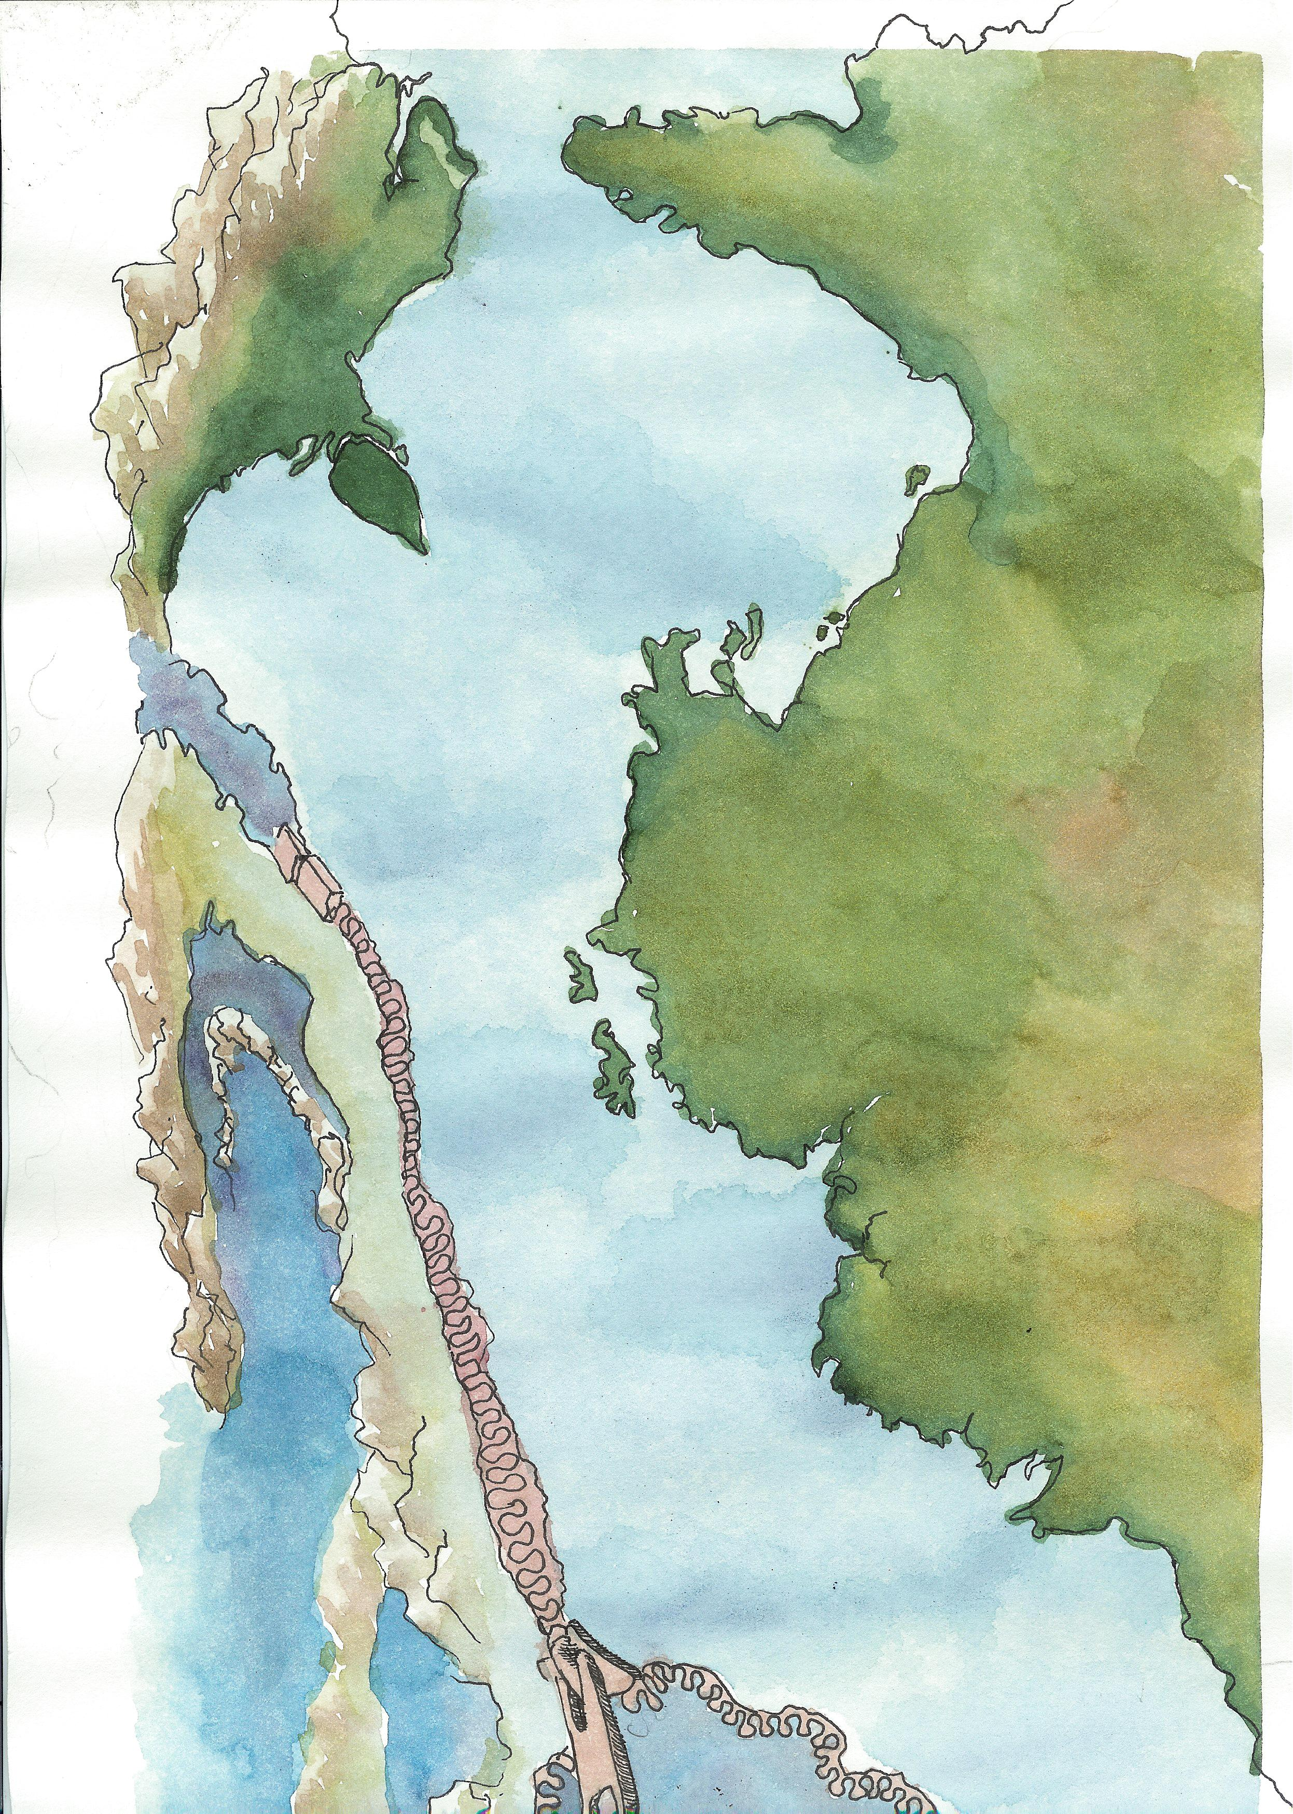
Using GPS to measure strain accumulation
No Motion
63%
22%
41%
GPS Velocities Relative to Asia

Slide 25
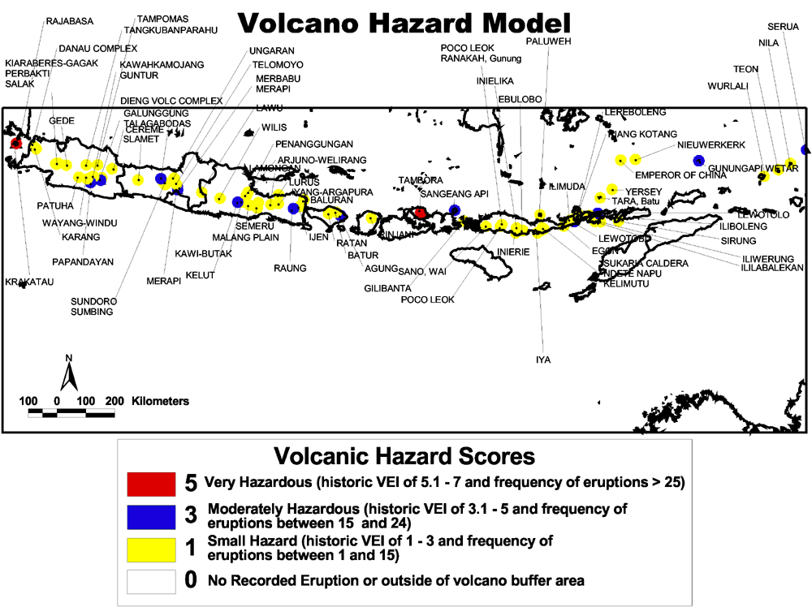
Notes:
Most volcano hazard assessments comprise maps depicting zones around a volcano that are likely to be directly affected in the event of an eruption. Such an assessment begins by examining past eruption frequency rates. The frequency of past eruptions and by conducting topographic and stratigraphic studies around the volcano. Based on collected data, hazard zones are delineated around the volcano.
Active volcanoes were buffered to 8km a distance chosen from the Volcanological Survey of Indonesia (1999) descriptions of hazard and alert zones for most actively monitored volcanoes in Indonesia. The vast majority of volcanoes have delineated hazard zones within 5km radii from the eruption centers, and alert zones of between 5-8km distance from eruption centers.
Volcanic hazards were evaluated based on the frequency of eruptions and historic VEI values. The majority of volcanoes have VEI values ranging between one and three, while the more violent eruptions with VEI values over three, tend to be evenly distributed through the volcanic arc. The final volcano hazard model additively combined both grids.
The model shows that Java is influenced most by frequent, high VEI eruptions.
The highest concentration of volcanic activity is where old oceaninc lithosphere is subducted at highrates along the Sunda Arc in Java.

Slide 26
Conclusions
400 year historical record provides a way to forecast what will likely happen in the near future.
Using tsunami to tracers to find source regions of major earthquakes and volcanic eruptions.
Millions of people at risk in central to eastern Indonesia.
We need to empower those actually in Harms Way to protect themselves.
Low Tech solutions should be exhausted!

Slide 28
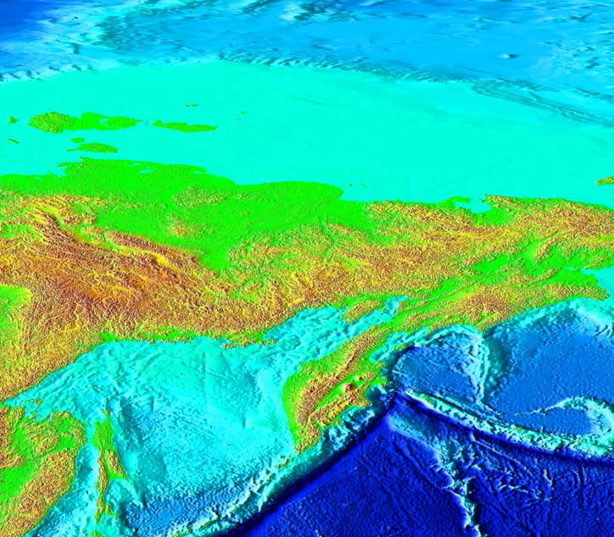
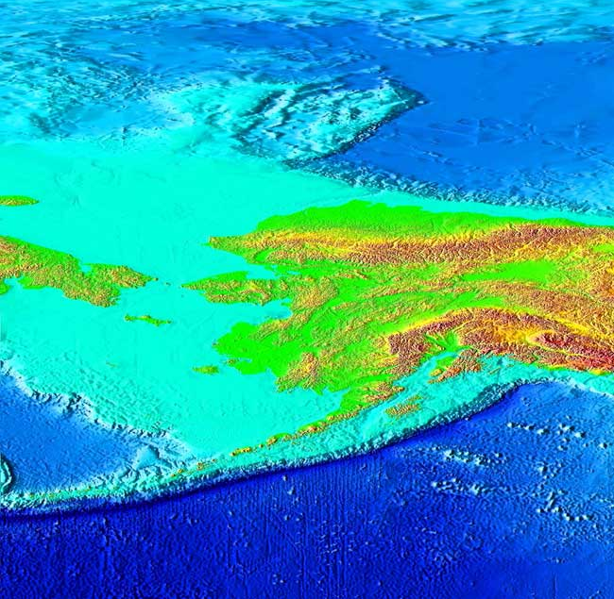
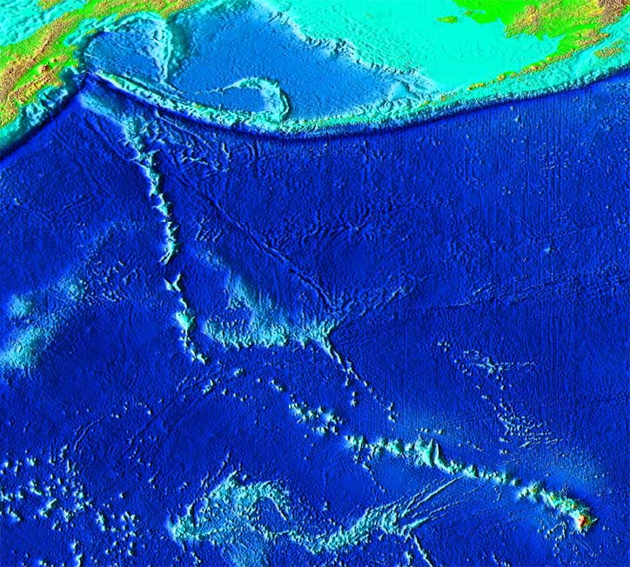
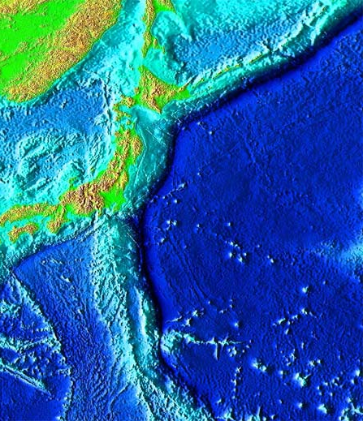
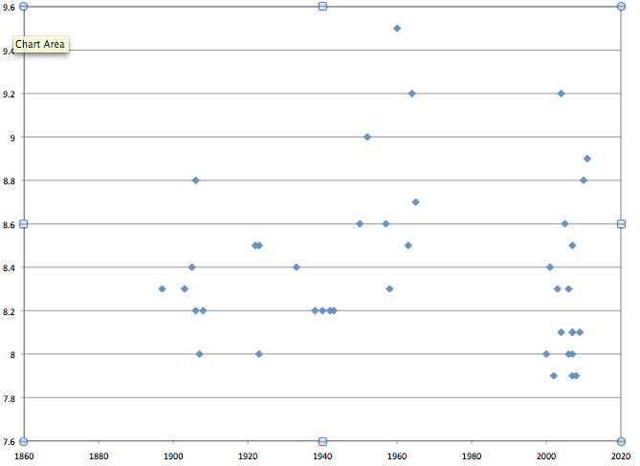
First Instrumented Earthquake Storm?
7/1958 8.3
1946 ~8.6
3/1957 8.6
1948 ~8.0
11/1952
2/1965 8.7
9.0
11/1958 8.7*
1938 8.3*
3/1964 9.2
4/1959 8.5*
Many quakes <8
8.3 11/06
3/1952 8.6*
1963 8.5
9.4
9.0
8.6
8.2
7.8
2003 8.3
1952 8.0
2011 9.0 (Previous event in 1896 8.5)
Magnitude
10 cm/yr.
(2.5 in/yr.)
1923 8.0 150,000 deaths
1944 8.0
1946 8.0
1880 1920 1960 2000

